Slide 1

ALY6040:Data Mining Applications
Group 3
Ajay Reddy
Rambhupal
Ramyashree

Slide 2
Background Information
Dataset
The London listings Airbnb dataset comprises 66,640 observations and twenty-one variables.
Goal
This final project aims to build a classification model to estimate the property's price in the Airbnb listings by considering the property's size, longitude, scope, location, and other variables.

Slide 3

Research Questions
Which Neighborhood has the highest number of listings?
What are the highest and least available room types in the property listings?
Most listings are under which price?
Do the location and other features significantly impact the price of listings?

Slide 4

Approach
Descriptive Statistics
Predictive Models
Exploratory Analysis
Model Evaluation
Data imputation
Correlation Analysis
Data Splitting

Slide 5
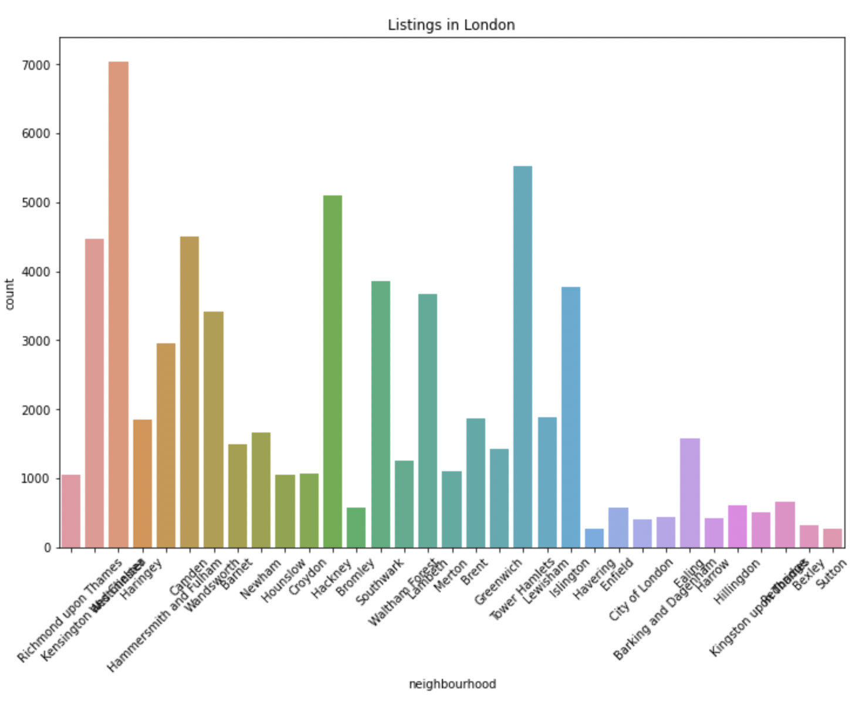
Neighborhood which has the highest number of listings
The exciting thing about the above distribution is “Richmond upon Thames” neighborhood has the highest listings, and Islington has the lowest listings.

Slide 6
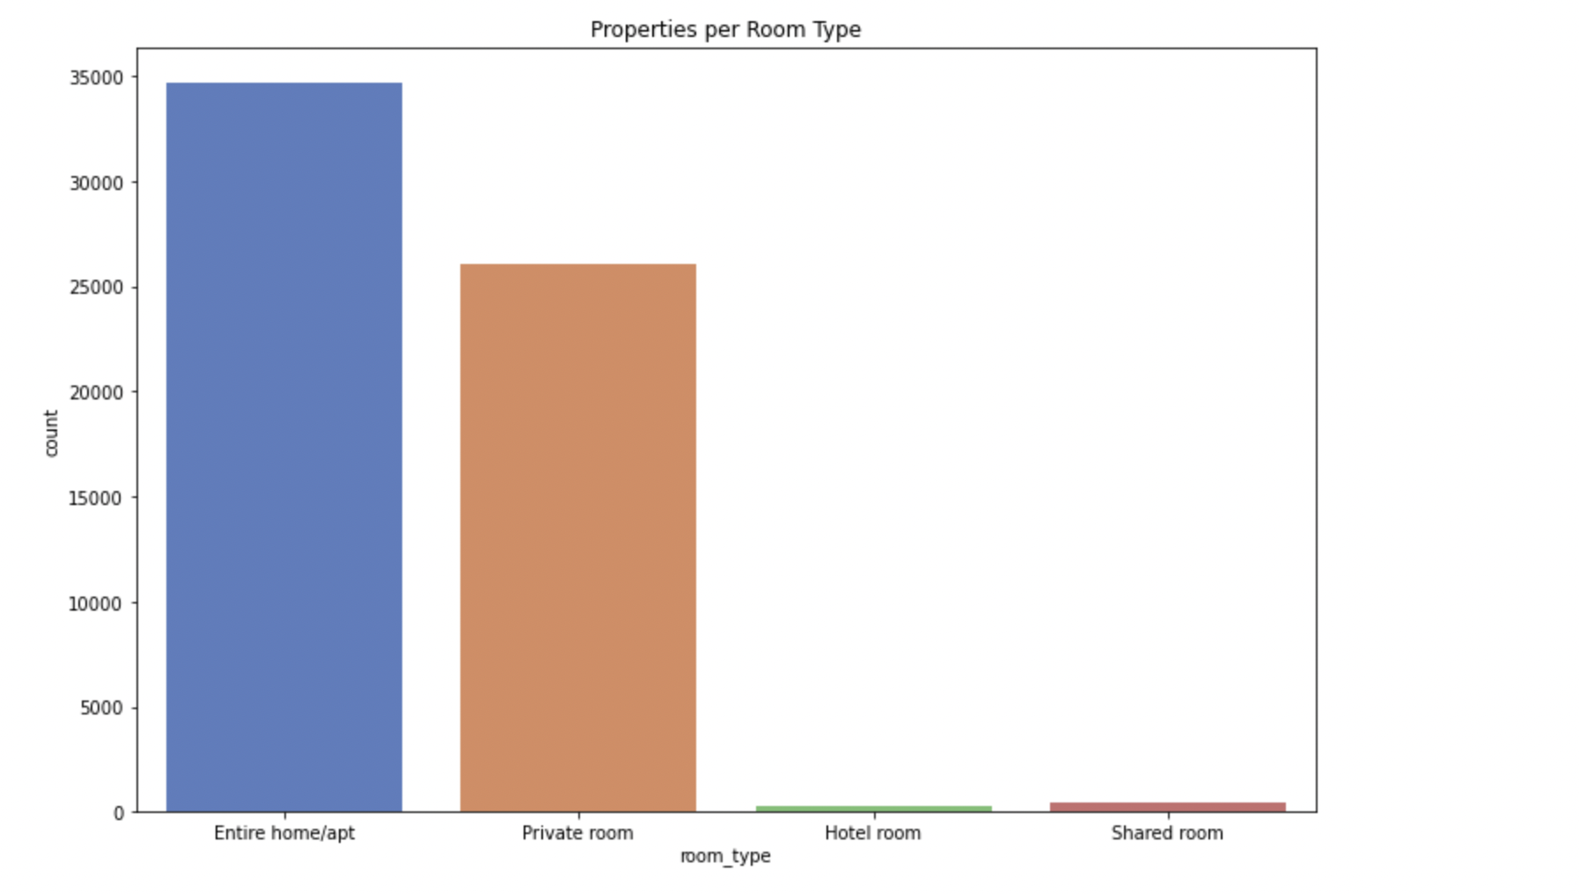
Highest and Least available room types in the property listings
More than 30,000 entire home/ apt type rooms are followed by the private room of more than 25000. Hotel rooms and shared rooms are the least available room types in the property listings.

Slide 7
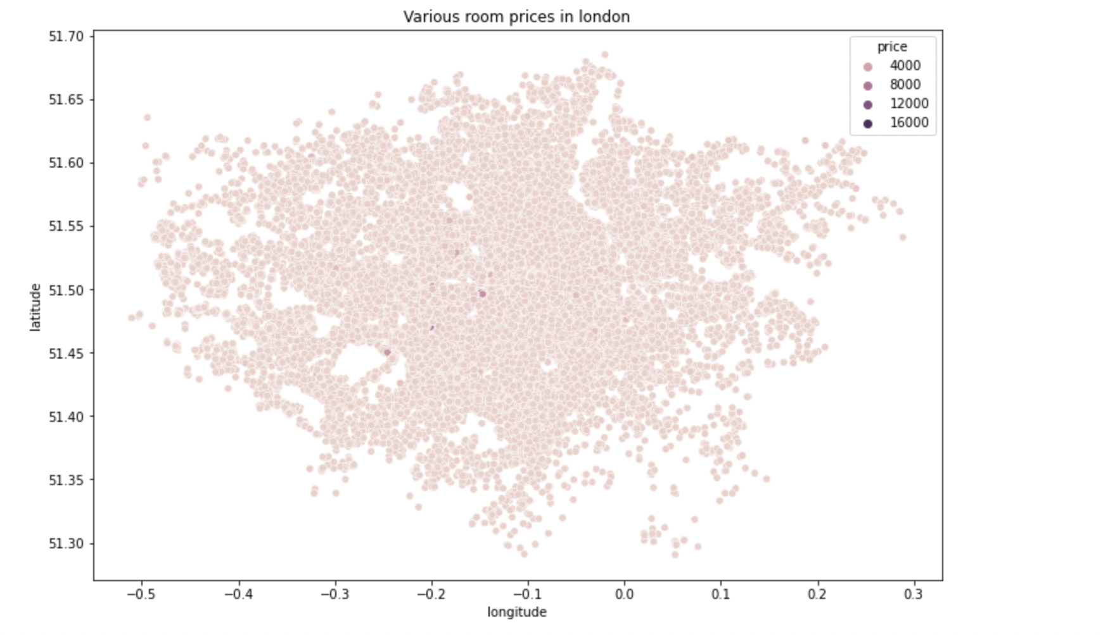
Listings room prices
We have plotted the scatterplot between the longitude and latitude to know the distribution of price based on the location, and we found that most of the room prices are in the 4000s.

Slide 8
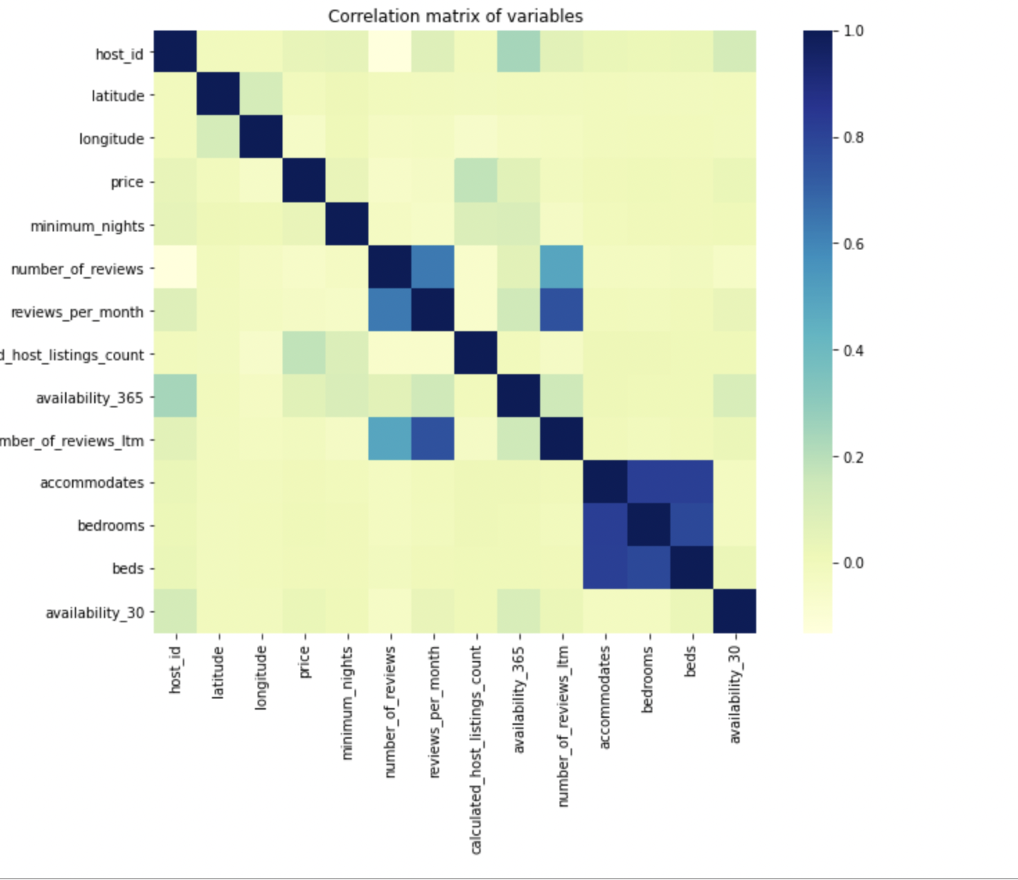
Correlation
Analysis
It disappointed us a bit as we discovered that the price doesn’t significantly correlate with other features. Several host listings and availability 365 had very little correlation, less than 0.2. Moreover, we can’t accurately determine the impact of location on the price as we correlated the price with longitude and latitude rather than combining them as a location.
Notes:
Both cor and scar haver the most data ink rate
Edward Tufte’s Rules:
- visualization, a single heatmap to know preference and behavior data, and social economic overlook
Data divided into three groups
Demo, system, economic
Also two category
People subscribe: subscriber
People in general: population
Preference or behavior: preference is the summary of the past, behavior is how the past influence the future
Call center preference
call center's predictive algorithm on which customer to callback,
smaller company Employe vs prev, 3,6,9,12 call time pattern,
Friday omitted, of course, usually the workflow : client submission on Monday, Wednesday for demo and Friday for product launch and testing period
Behavior:
the people who are subscribed to both deposits are less likely to go to bigger company (nr employed vs y=yes)
They don't respond, as the more they get calls, (no of calls vs duration alpha = -0.15)
Easy insight from call campaign strategy:
The more calls agent do, the less time people will talk and more likely to unsubscribe
People who age talk more, if we want to save money and time, finding the CI for a customer is the key, the upperbound will optimize call time
Conclusion 1:
To answer one key question
People will deposit the more agents call (higher +ve correlation campaign, pdays for target group), but they won't deposit when the calls are too frequent
Horizontal comparison:
Shift in behavior: expected in order to classify people
They are more likely to be influenced by the bank marketing (increase from 0.05 to 0.21 between duration and age, and 0.013 to -0.23 for confidence index, the shift in correlation suggests that people with these behaviors are more likely to buy).
General behavior: indifference
we will get almost no correlation (-0.085) between agents calls and the will to talk for the population, but some correlation in the subscriber subgroup
Behavior difference
They are more likely to talk 200 seconds or more, more than the people done in general (82.35% instead of 65.05%).
Self-employed or students don’t get called again, and 5.13% more people (comparing to people in general campaign and people has campaign loyalty) made the decision with only 1 call (61.76% vs 56.63).
Bank's preference:
After making some comparisons, only the target consumer’s education level (54.29%) is somewhat moderately more than the general sample’s education (42.17%), the marital status(51.43% vs 50.60%) and the loan status (20% vs 18.07%) doesn't really change.
Bank prefers higher education
Age shows higher correlation in the subscriber subgroup
Conclusion extended:
Social overlook
The negative correlation suggests an obvious but easy to forget insight,
financial confidence is not related to jobs or age, but rather than the interest rate you bank provide (correlation = 0.68). people are logical animals whose behaviors can be predicted
-user profile, prediction on who will be subscribed
-- 30 – 40 years old – talk longer time as they age, presented in the first row
-- previous: days waited between calls, inverse relation emp var, euribor interest rate, number employees
-- -- less confidence on financial, third last row,
-- little to o money,

Slide 9
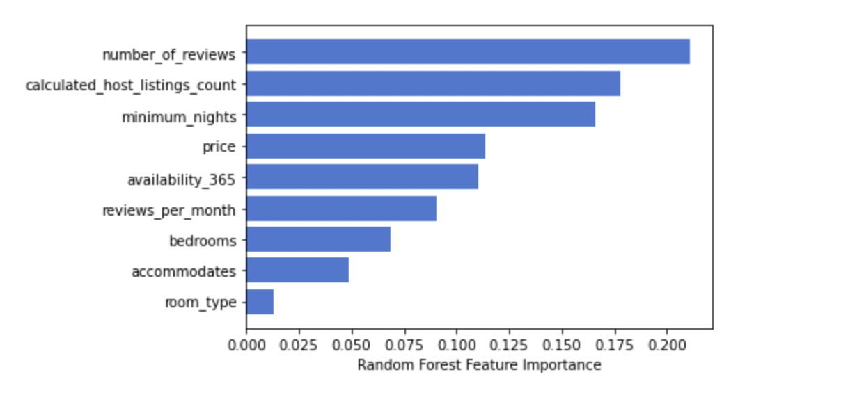
Predictive Models
We used Gaussian Mixture model to predict the price based on the cluster; we can predict neighborhoods, Airbnb hotel listings & price range.
Then we predicted the price of each cluster using random forest classification with the dependent variable as price and the independent variable as cluster number.
But we got an accuracy score of 5%, As the accuracy was very low, we took top 5 essential features from the above random forest classification model to fit the model using them. But then we didn’t get high accuracy.
So, we classified the price into various ranges like economic, low-mid, high-mid & high.

Slide 10
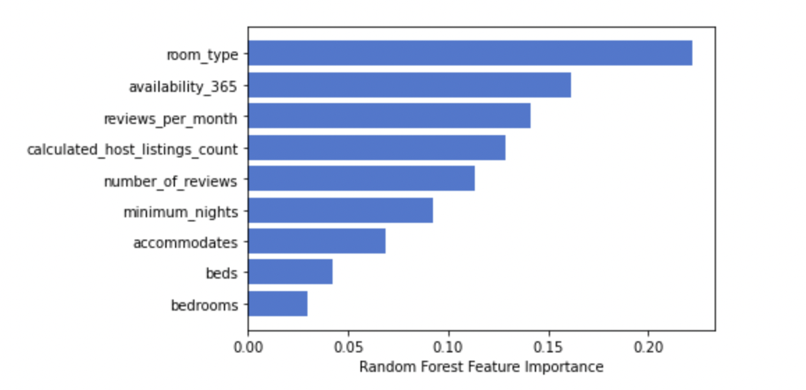
Predictive Models
We classified the price range based on features shown right side using the K-NN and random forest classification and we got the accuracy of 68.66 and and 68.93 %.
Then we again classified the price range with only top5 important features using the K-NN and random forest classification and we got the accuracy of 68.86 and and 68.36 %.

Slide 11
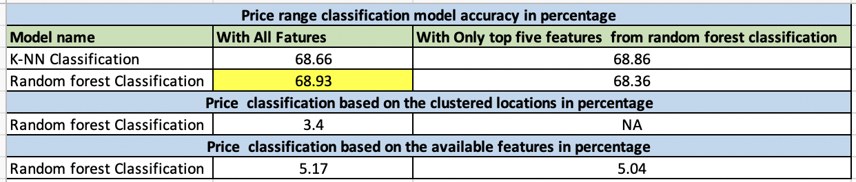
Comparison & Model Evaluation
Among all the models, the Random Forest classification model includes all the features in classifying the price range and has the highest accuracy of 68.93 percent. So, 68.93 percent of the time, the classified price range is accurate.

Slide 12
Conclusion & Future works
We used Gaussian mixture model to cluster the data and predicted the prices based on the clusters using random forest regression as it helps in the feature section. But the accuracy was only 5%.
Instead of classifying price, we grouped the price data into four categories based on the price range. With available data and a classified random forest model, we could classify the price accurately 68.93 percent of the time, which is better than the classifying price.
Considering these two points, we would recommend considering a classifying the price into various range.
In future, we will try classifying the price and price range without the outliers and imputing the median and mode in the place of outliers.
But we think there might not be much difference in the accuracy as there are only a few outliers in the dataset.

Slide 13

References
A Guide to Data Clustering Methods in Python. (n.d.). Retrieved from builtin.com: https://builtin.com/data-science/data-clustering-python
Build Better and Accurate Clusters with Gaussian Mixture Models. (n.d.). Retrieved from www.analyticsvidhya.com: https://www.analyticsvidhya.com/blog/2019/10/gaussian-mixture-models-clustering/?
GMM: Gaussian Mixture Models — How to Successfully Use It to Cluster Your Data? (n.d.). Retrieved from towardsdatascience.com: https://towardsdatascience.com/gmm-gaussian-mixture-models-how-to-successfully-use-it-to-cluster-your-data-891dc8ac058f
Inside Airbnb. I am adding data to the debate. (n.d.). Inside Airbnb. https://insideairbnb.com/get-the-data.html
Impute missing values with the model in the Python code example. (n.d.). Grepper | The Query & Answer System for the Coder Community. https://www.codegrepper.com/code-examples/python/impute+missing+values+with+mode+in+python
Pierre, S. (2020, June 8). Pandas tricks for imputing missing data. Medium. https://towardsdatascience.com/pandas-tricks-for-imputing-missing-data-63da3d14c0d6
The penalty for missing values in data science. (2019, February 8). freeCodeCamp.org. https://www.freecodecamp.org/news/the-penalty-of-missing-values-in-data-science-91b756f95a32/

Slide 14

Thank You
Any Questions?

